Slide 1
Christin Bailey
Volunteer Applicant for the
Big Brothers Big Sisters Organization

Slide 2
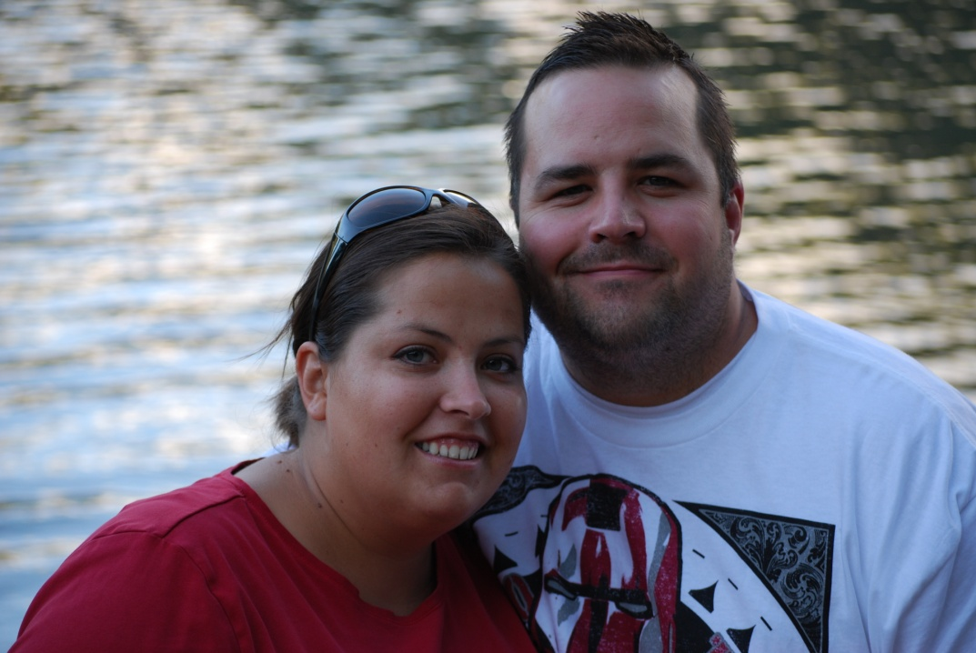
Information About Me:
A little about me
My background
My personal interests

Slide 3
A Little About Me
29 years old
Married for 10 years
Mother to three children
Active in community
  Volunteer weekly at local elementary school
  Serve in Neighborhood Watch

Slide 4
My Background
Grew up in New Mexico
Speak fluent Spanish
Five siblings
Certified foster parent
Completed numerous child development classes
Worked with children in church-related program for 10 years

Slide 5
My Personal Interests
Camping/Backpacking
Photography
Learning about other cultures
Reading
Rock climbing
Animals
Anything outdoors

Slide 6
Why I Would Make a Good Big Sister
I have previous experience working with children, and I would love to make a positive impact on a child’s life!

