Slide 1
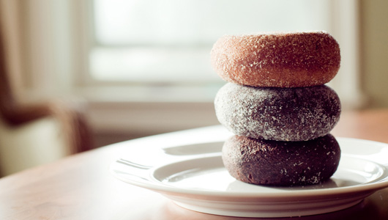
Through the Doughnut Hole
A Sweet History with Colorful Sprinkles & Raised Questions About Where to Get Them

Slide 2
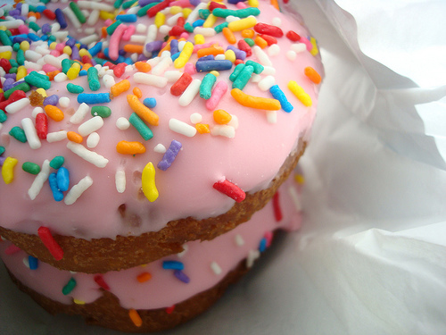
Donut or Doughnut?
• Merriam Webster: “doughnut”
• Donut spelling 1800s

Slide 3
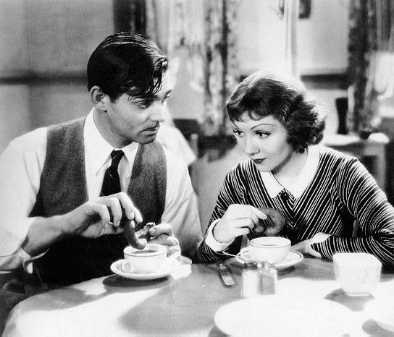
Statistics:
1929 Americans ate 216 million donuts
Today (2013) we eat close to 10 billion a year

Slide 4
Brought by Dutch Immigrants
1600s: New Amsterdam, South Manhattan Island
1800s: Called “Olykoeks” a.k.a. oily cakes in cookbooks
1860s: Indian fry bread (Navajo tradition)

Slide 5
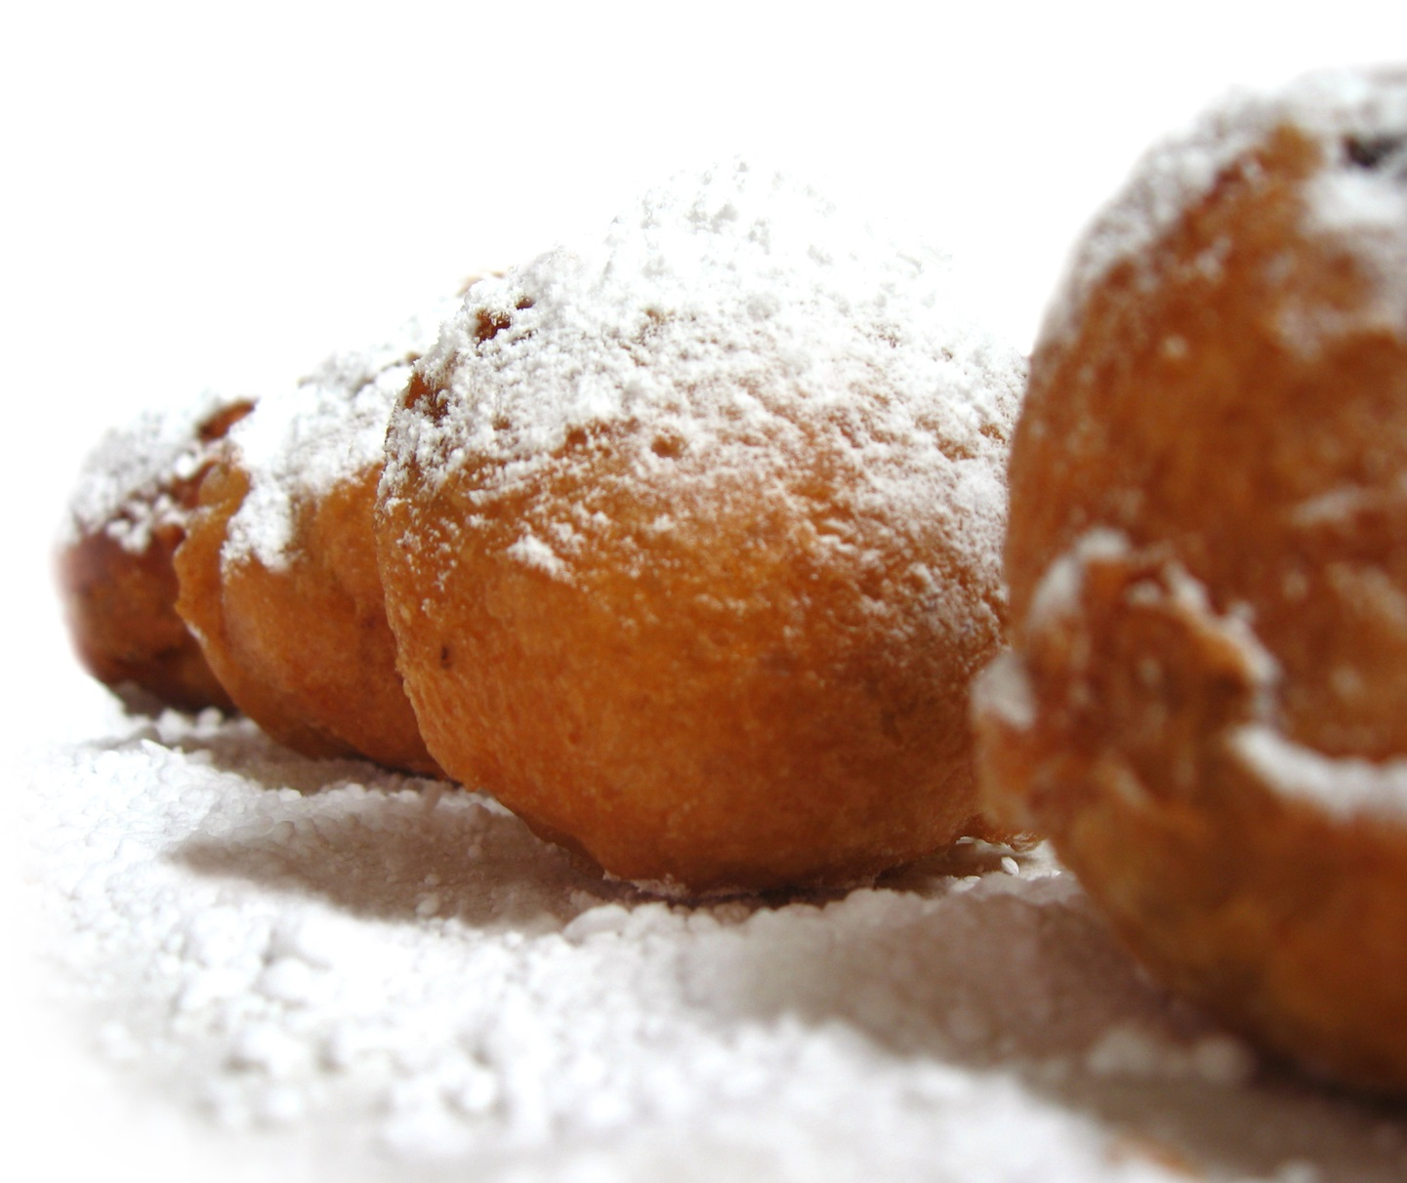
“The Dutch olykoeks as described in books about old New York are evidently a mouth-watering concoction,” - The New York Times, 1937

Slide 6
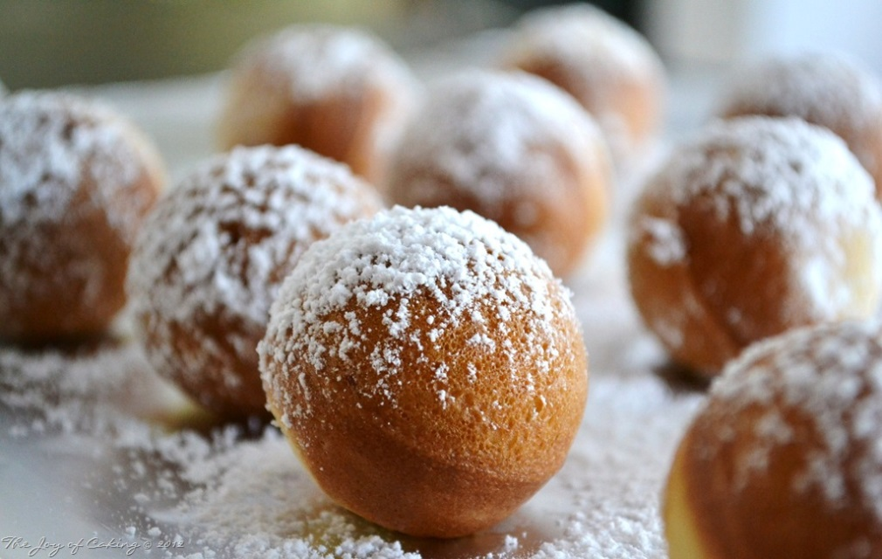
Why is There a Donut Hole?
Dilemma: centers didn’t cook
Mid 1800’s-Captain Hansen Gregory
cut a hole
Increased surface area

Slide 7
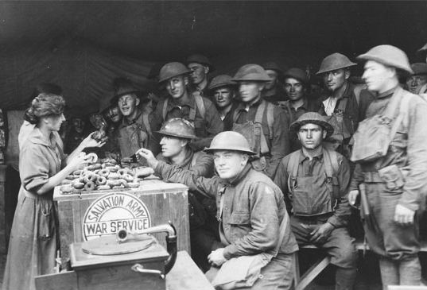

Slide 8
War and Doughnuts?
WWI & WWII – Salvation Army Lassies
Doughnuts cooked in battle helmets
Served to troops
American Red Cross: Donut Dollies (627 young women)
Vietnam War
College graduates sent to lift spirits of troops
Ran recreation centers

Slide 9
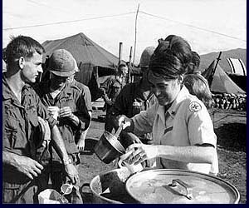
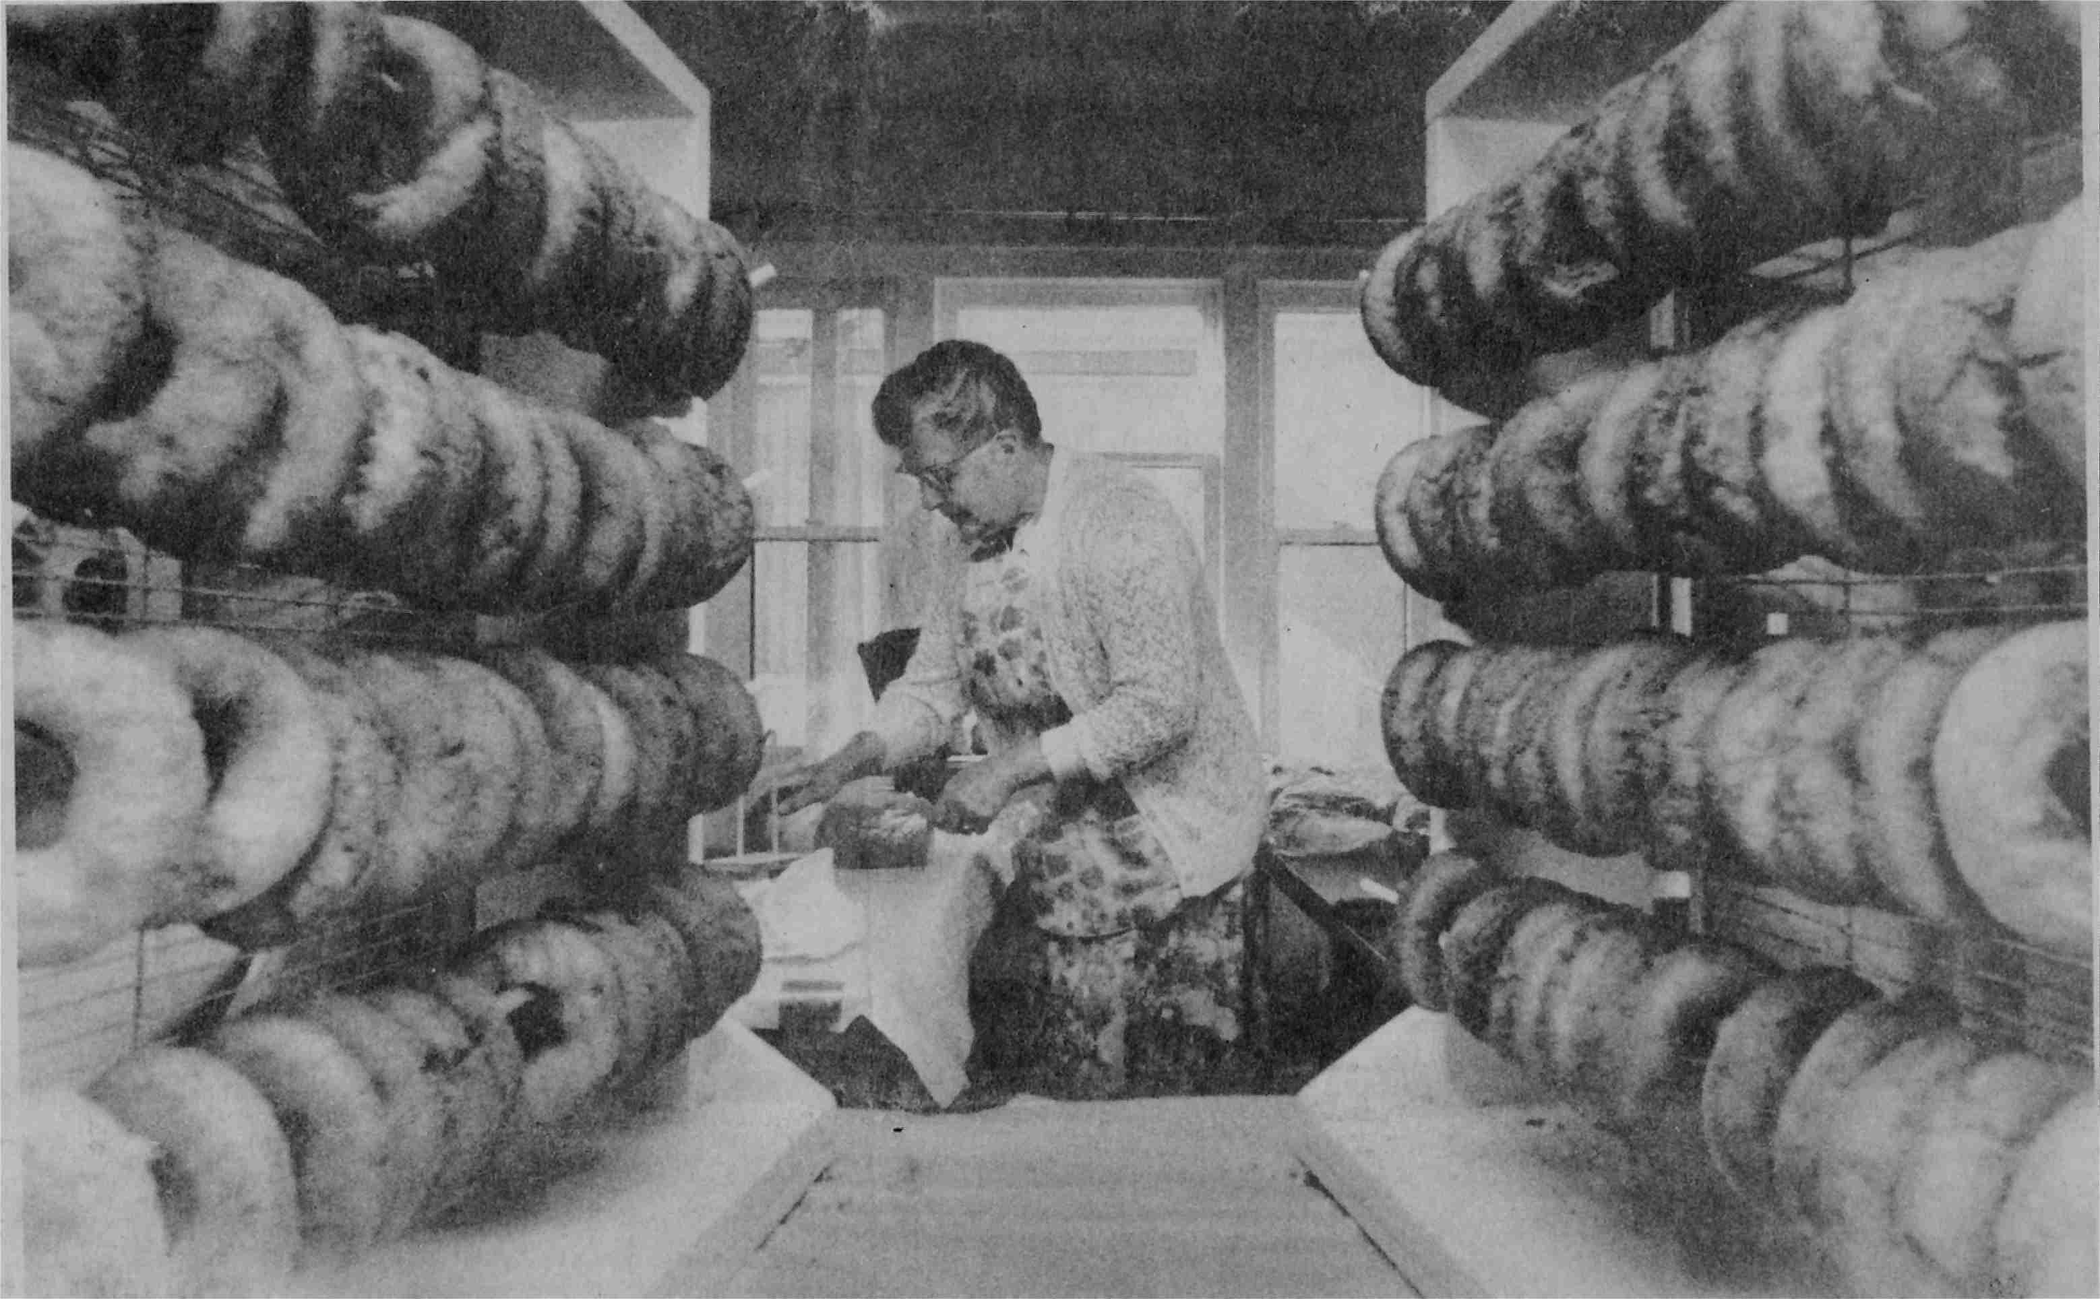

Slide 10
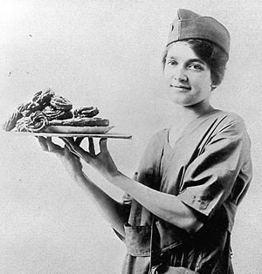
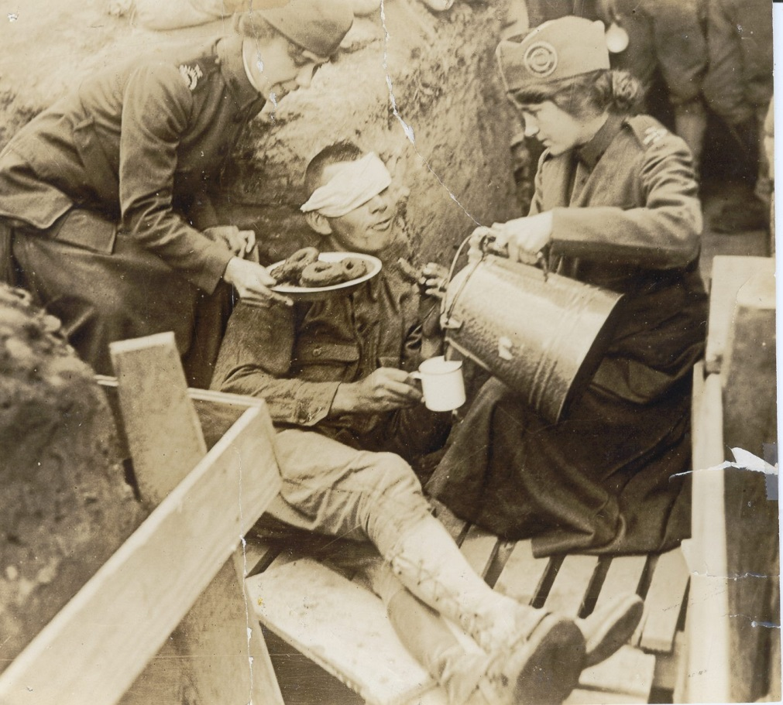

Slide 11
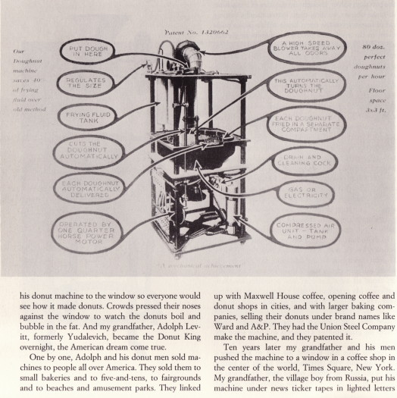
Automated Donut Machine
1920 created by Adolph Levitt,
Russian refugee
1934 World Fair posters:
“The food hit of the Century of Progress”
Cost: $.05
Patent

Slide 12
Doughnut Shops
1930s: Krispy Kreme recipe acquired
Frenchman Joe LeBeau sold recipe to Ishamel Armstrong
1950s: Dunkin Donuts opens in Massachusetts
Dunkin has twice as many stores as Krispy Kreme (and is in 37 countries)
Some doughnut shops open 24-hours

Slide 13
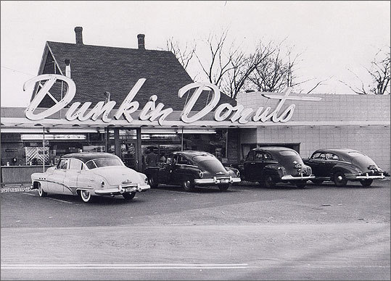

Slide 14
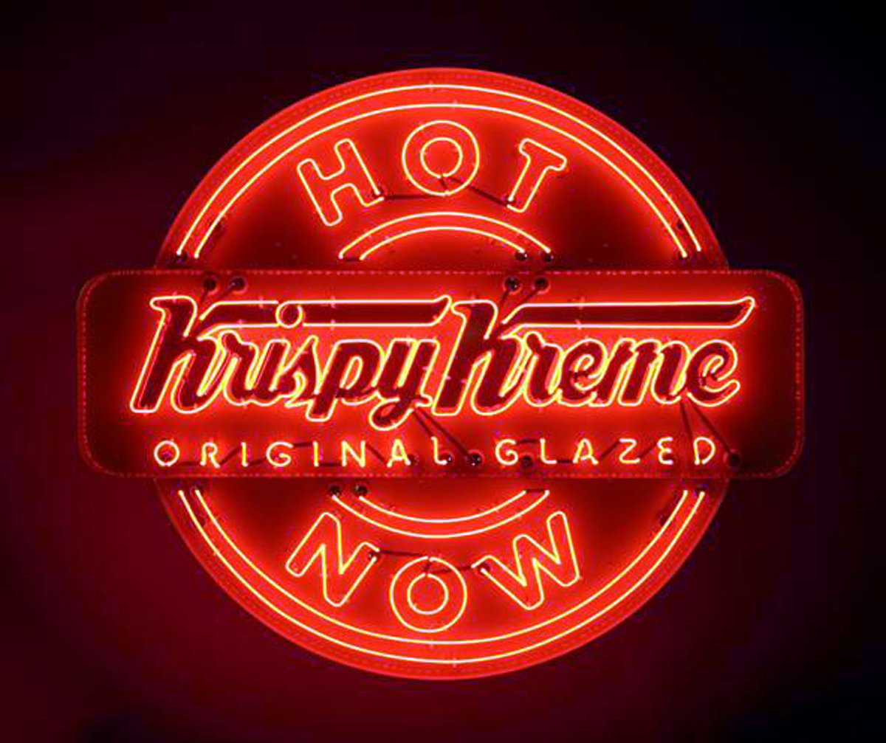

Slide 15
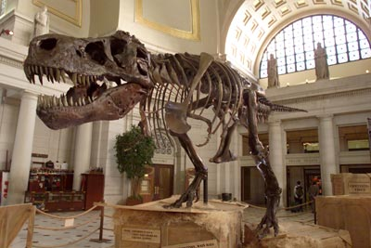
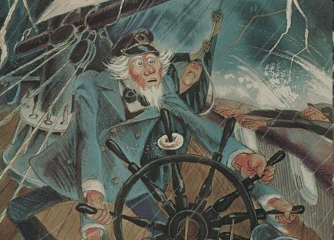
Urban Legends
Fossils of donuts at Indian Settlements?
Sea captain with doughnuts on the ships wheel?

Slide 16
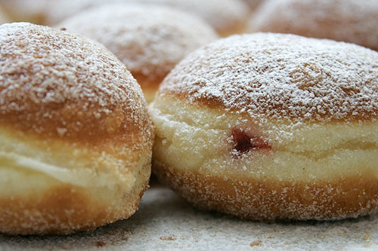
Urban Legends
Did J.F.K. say “I am a jelly doughnut.” When he stated: “Ich bin ein Berliner” (starts at 1:33 audio sample)

Slide 17
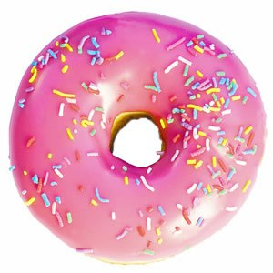
Delicious Donuts

Slide 18
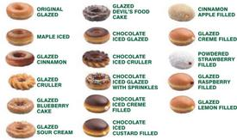
Different Flavors of Donuts
Buttery Finger: chocolate glaze, crushed Butterfinger candy pieces
Caramel Delight: chocolate glaze, toasted coconut, caramel drizzle
Chocolate Covered Banana: banana glaze, chocolate drizzle
Creamsicle: orange creamsic le glaze
PB&J: strawberry glaze, peanut butter chips
Peanut Butter Cup: chocolate glaze, PB chips
Pina Colada: pineapple glaze, toasted coconut, rum drizzle
S’more: chocolate glaze, graham cracker, toasted marshmallow fluff drizzle

Slide 19
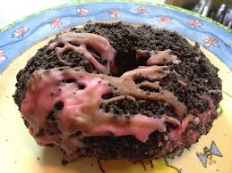
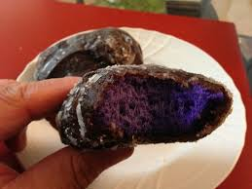
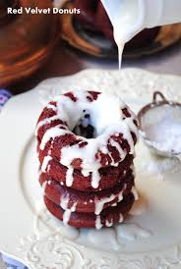
Different Kinds of Glazed Donuts
Chocolate
Vanilla
Honey
Marshmallow
Maple
Pineapple
Strawberry
Caramel
Blueberry
Banana
Raspberry

Slide 20
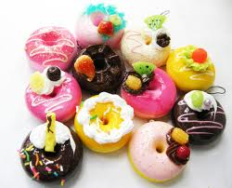
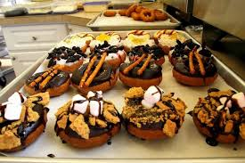
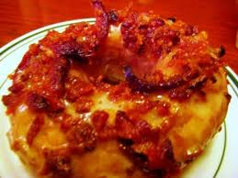
Some Tasty Toppings
Rainbow & chocolate sprinkles
Peanut butter chips
Chocolate chips
Toasted coconut
Chocolate cookie crumbs
Graham cracker crumbs
Crushed peanuts
Crushed Butterfinger pieces
Bacon

Slide 21
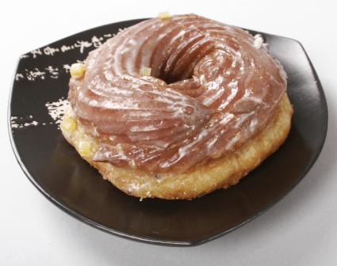
Recipes for Different Types of Donuts
Raised Donuts: The raised donut has yeast in its dough, allowing it to rise to a light and airy consistency.
Cake Donuts: Cake donuts use a batter similar to that of cake and generally use baking powder for their limited rise. Denser than their raised counterparts, cake donuts are less delicate and more substantial.
Crullers: The name cruller is actually used to describe two different styles of donuts. One is also called the "French Cruller," which is a fluted circular donut, with a puff pastry-like texture - lightly crispy on the outside and slightly eggy and moist on the inside.

Slide 22
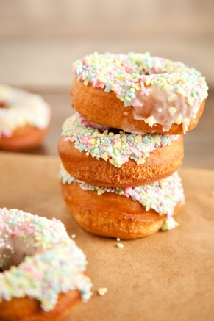
Just a Few Great Recipes
Baked Cake Donut Recipe
Ingredients
2 cups all-purpose flour
3/4 cup white sugar
2 teaspoons baking powder
1/4 teaspoon ground nutmeg
1/4 teaspoon ground cinnamon
1 teaspoon salt
3/4 cup milk
2 eggs, beaten
1 teaspoon vanilla extract
1 tablespoon shortening
1 cup confectioners' sugar
2 tablespoons hot water
1/2 teaspoon almond extract
Instructions
Preheat oven to 325 degrees F.
Blend together the flour, sugar, baking powder, nutmeg, cinnamon and salt.
Mix in the milk, eggs, vanilla, and shortening until smooth.
Fill each cup of a greased muffin tin 2/3 with batter.
Bake 8 minutes.
Nothing beats a homemade yeast donut y’all!
Servings: 12
Prep Time: 2 hours
Cook Time: 15 min
Difficulty: Easy
Ingredients
3/4 cup warm milk 1 packet active dry yeast 1/4 cup granulated sugar 2 1/2 cups all-purpose flour plus extra for dusting your dough and board 1/4 teaspoons kosher salt 2 tablespoons unsalted butter, at room temperature 2 egg yolks Nonstick cooking spray Peanut Oil for frying (Can substitute vegetable oil
Serve and enjoy!

Slide 23
Some Other Great Healthy Choices
Gluten Free Donuts
FOR THE BATTER:
1/2 cup raw whole cashews
1/2 cup blanched almonds
1/4 cup grass-fed butter {those who are casein-free, sub coconut oil here}
2 Tbsp of raw honey
3 pastured or organic eggs
1 tsp of vanilla extract
1/2 tsp of baking soda
1/4 tsp of sea salt
1 tsp of cinnamon
1/2 tsp nutmeg
FOR THE TOPPING
1 T Cinnamon
3 T Sugar {you can use coconut sugar here too if you need lower glycemic or are avoiding grains}
1/4 cup melted grass-fed butter or coconut oil
Sugar Free
1 can of refrigerated biscuits corn oil equal 2 tsp cinnamon [1] Set the biscuits out and let them get to room temperature [2] Create a hole into the middle of each biscuit [3] Drop biscuits into hot oil (be careful!) and let brown [4] Turn and let the other side brown **be careful, if the oil is too hot, your biscuits will burn** [5] Lift with tongs and put onto paper towel [6] Roll in equal and cinnamon ¼ cup cold low-fat or evaporated skim milk ½ tsp vanilla 3-6 tbsp sugar-free Cool Whip 2 tbsp non-instant, sugar-free pudding mix (chocolate, vanilla, etc) Directions: [1] Stir together milk and vanilla [2] Add Cool Whip, whisking constantly until icing reaches desired consistency. [3] Mix in the pudding mix until well combined [4] Frost the (room-temperature) donuts

Slide 25
Unique Donuts From Around The World

Slide 26
Spain
Banana Daiquiri/Mohito
Pumpkin

Slide 27
China
Pork Floss
Dried Pork and Seaweed

Slide 28
Korea
Garlic Glazed
Green Tea

Slide 29
Korea
Kimchi Filled
Red Bean Bismark

Slide 30
Thailand
Khanom Krok
Square

Slide 31
Indonesia
Durian Fruit
Red Bean

Slide 32
Japan
Bean Jam

Slide 33
Singapore
Wasabi Cheese
Seaweed Cheese

Slide 34
Psycho Donuts California
Donut “Fries”
Dead Elvis

Slide 35
Voodoo Doughnuts Oregon
Bacon Maple Bar
Bubble Gum

Slide 36
Voodoo Doughnuts Oregon
Captain My Captain
Tangfastic

Slide 37
Best Donut Shops in the Salt Lake Area

Slide 38
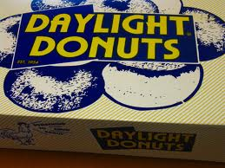
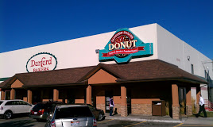
Donut Shops and Addresses
Daylight Donuts
125 E. State Rd., Pleasant Grove
Dunford Bakers
8556 S. 2940 W.,
West Jordan

Slide 39
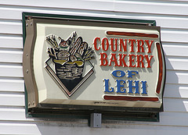
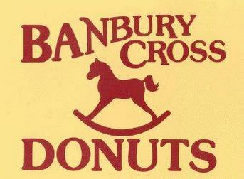
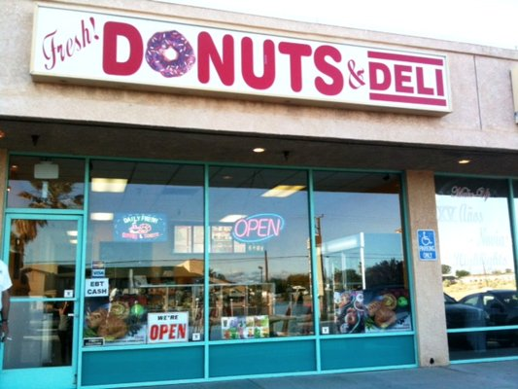
Lehi Bakery
172 W. Main,
Lehi
Danbury Cross
705 S. 700 E.,
Central
Fresh Donuts and Deli
2699 S. State,
South Salt Lake

Slide 40
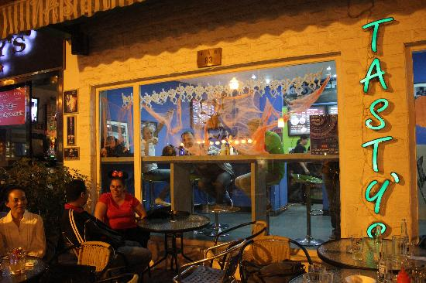
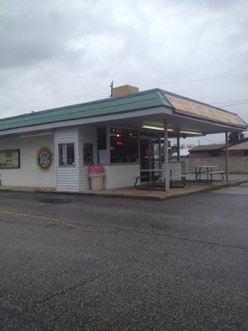
Tasty’s
612 N. Main St.,
Kaysville
Hole
1987 W. 4800 S.,
Roy

Slide 41
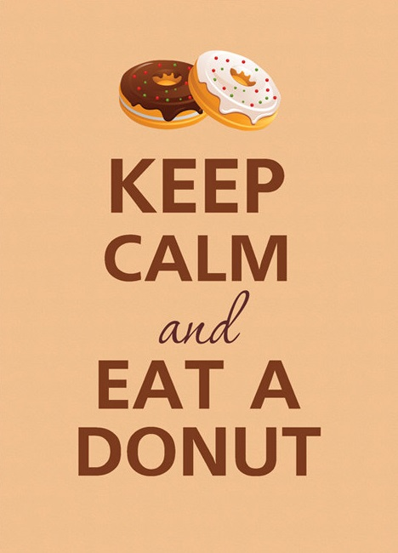
www.etsy.com/listing/80407228/keep-calm-and-eat-a-donut

